Slide 1
External project review team-13
Team Members:
Ch. Varsha - 20R21A6610
V. Arun Kumar - 20R21A6656
M. Jahnavi - 20R21A6635
S. Sai Krishna - 20R21A6648
Guide:
Mr. J. Vijay Gopal (Assoc. Prof)

Slide 2
Infobot - A Robot that recognizes objects/faces and extracts information about them.

Slide 3
Introduction:
Introducing a groundbreaking project: an intelligent robot equipped with speech, object, and face recognition capabilities. This innovative system aims to engage users in friendly conversations while identifying objects and faces, enhancing user experiences across various domains. With advanced technology and user-centric design, it promises to redefine human-robot interactions.

Slide 4

EXISTING SYSTEM:
The existing system of Chatbots, however, encounters hurdles when it comes to attaining humanlike communications owing to the zero contextual comprehension and no emotional Intelligence. The fuzzy and difficult nature of the questions and data, thus, negatively affects the response rates. Prejudice and privacy
invitations must be carefully considered before anonymization. Bridging multi-turn communication issues and filling in the language gaps are very significant. The misjudgment, concerns of privacy, and looming of ethics with facial recognition technology like biases are the issues that may be compromising its implementation. Real-time object identification in computer vision remains challenging, with problems of accuracy improvement, speed, and scalability. Visitor monitoring systems may deal with privacy and accuracy problems even with the complexity in the case of their (visitor monitoring systems) Integration. The prospect of universal adoption of biometric systems is, beyond doubt, fraught with the problem of safeguarding security as well as privacy.

Slide 5
PROPOSED SYSTEM:
Developing a conversational robot
Innovative System to engage in friendly conversations
Enhancing user experiences in various functionalities like Speech, Object detection, face recognition
Enhancing the user with a Visitor Tracking system

Slide 6
OBJECTIVES:
Develop robust speech recognition and synthesis modules.
Implement efficient object recognition algorithms.
Integrate accurate face recognition technology.
Create a user-friendly robot for interaction.
Ensure seamless communication between modules.

Slide 7
ADVANTAGES OF PROPOSED SYSTEM:
Enhanced security with personalized access control.
Streamlined object categorization for efficient organization..
Real-time visitor monitoring for improved security.
Personalized assistance for recognized users' needs.

Slide 8
SOFTWARE REQUIREMENTS:
Operating System : Windows, Raspberry pi 64bit OS.
Programming Language : Python for implementing face recognition, object detection, speech analysis, tracking visitor information
Development Environment : Visual Studio Code.
Libraries : OpenCV, NumPy, Face Recognition, OpenAI, Speech Recognition, pyttsx3, smtplib, email.

Slide 9
HARDWARE REQUIREMENTS:
Device : Raspberry pi 5
Operating System : Raspberry pi 64bit OS
Processor : 64-bit 2.4 GHz quad-core ARM Cortex-A76
Ram : 4 GB (minimum)
Hard Disk : 256GB (minimum)
Output Devices : Speaker.
Input Devices : Keyboard, mouse, Camera, Mic.

Slide 10
IMPLEMENTATION TECHNOLOGIES:
FACE RECOGNITION MODULE IN PYTHON:
Face recognition is a crucial aspect of computer vision applications. It involves identifying and verifying individuals based on their facial features. A face recognition module in Python utilizes various algorithms and techniques to achieve accurate recognition.
Python Libraries for Face Recognition:
OpenCV
Dlib
Face Recognition Library

Slide 11
YOLO PRETRAINED MODEL:
YOLO is a popular object detection algorithm known for its real-time performance and accuracy. The pretrained YOLO model in Python leverages deep learning techniques to detect objects in images or videos efficiently.
Python Libraries for YOLO:
Darknet Framework
YOLOv5
OpenCV

Slide 12
CONVOLUTIONAL NEURAL NETWORKS (CNN):
A Convolutional Neural Network (CNN) is a type of Deep Learning neural network architecture commonly used in Computer Vision. Computer vision is a field of Artificial Intelligence that enables a computer to understand and interpret the image or visual data. When it comesto Machine Learning, Artificial Neural Networks perform really well. Neural Networks are used in various datasets like images, audio, and text.

Slide 13
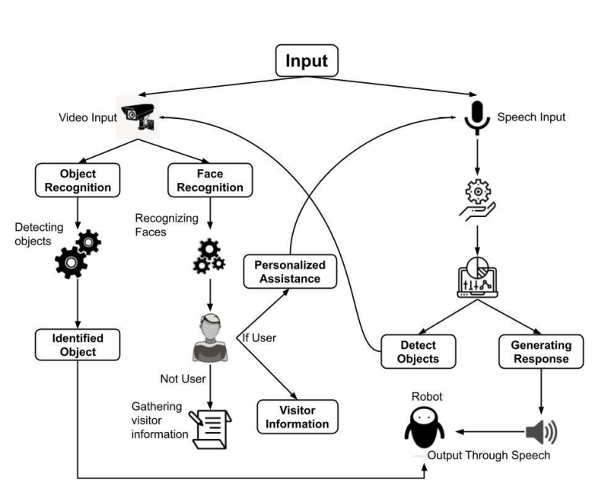
SYSTEM DESIGN:
PROPOSED SYSTEM ARCHITECTURE:
The proposed system encompasses the development of a robot that can recognize faces and objects and also extract information about them.

Slide 14
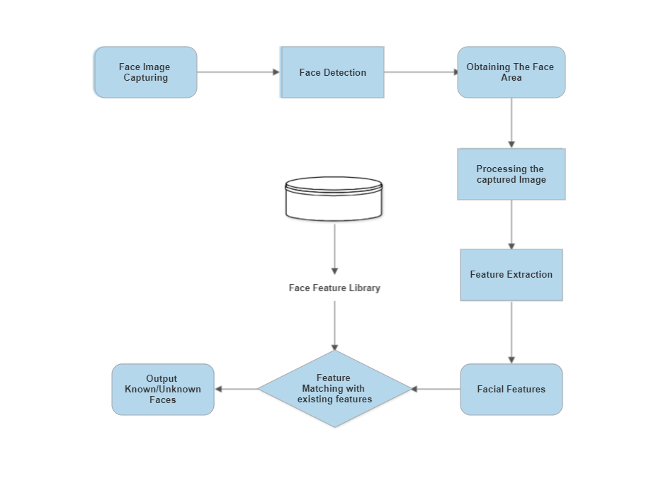
APPLICATION MODULES:
Face Recognition Module

Slide 15
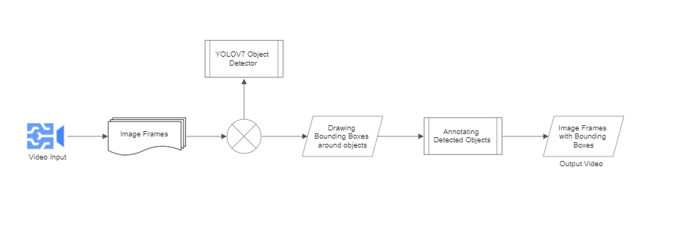
Object Detection Module:

Slide 16
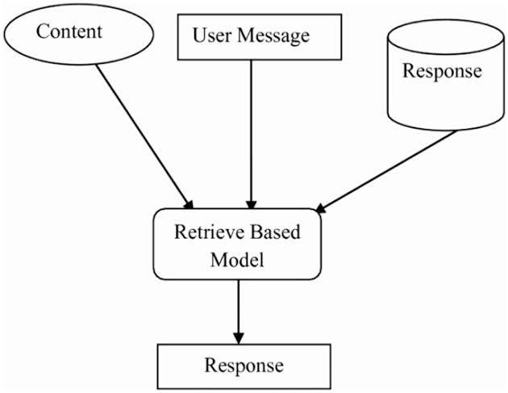
Chatbot Module:

Slide 17
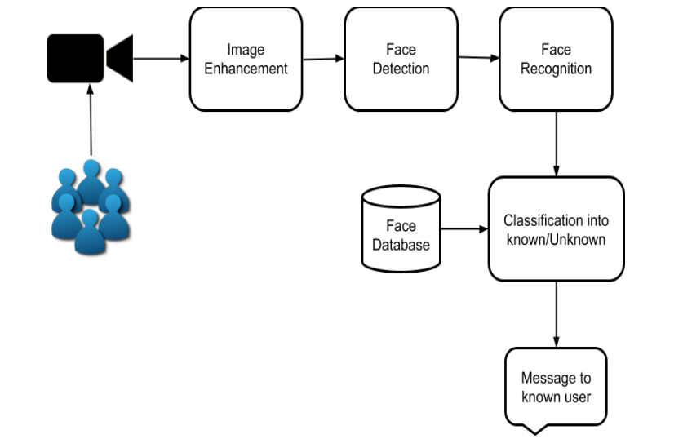
Visitor Tracking System:

Slide 18
PSEUDO Code:
Infobot:
function videocapture()
{
while (True)
{
frame=capture_video_frames()
save_image=input_boolean()
faces=capture_face_landmarks(frame,save_image)
result=faces.compare(user,faces)
if(result==user)
{
visitor=False
access_to_infobot=true
question=listen_to_user_speech()
if(question=="Recognize this object")
{
object=object_detection(frame)
speak("object is "+object)
}
response=infobot(question)
speak(response)
}
else
{
visitor=True
info=gather_visitor_information()
save_to_database(info)
}
}
}

Slide 19
Pseudo code:
Face Recognition:
function capture_face_landmarks(frame,save)
{
faces=face_encodings(frame)
if(save)
{
save_to_database(faces)
}
return faces
}
Object detection:
function object_detection(frame)
{
model=model.load("yolov5")
object=YOLO_model_find_object(frame)
return object
}
Chatbot:
function infobot(question)
{
bot=chatgpt()
response=bot.get_result(question)
return response
}

Slide 20
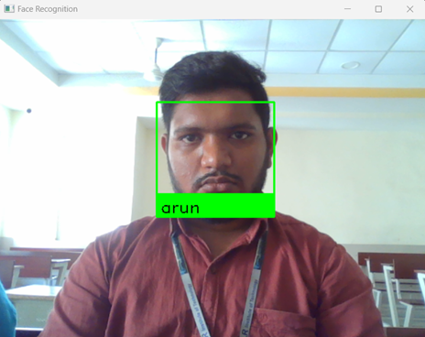
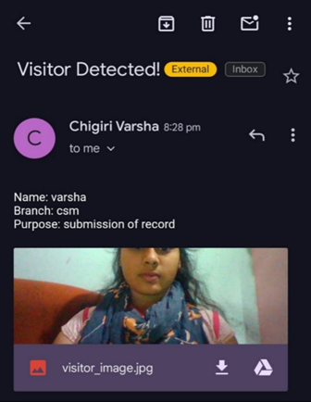
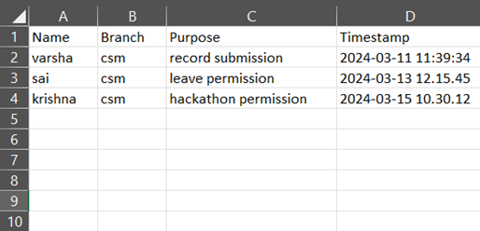
RESULTS
User Identifies as Known
Visitor Detected main to user
Information

Slide 21
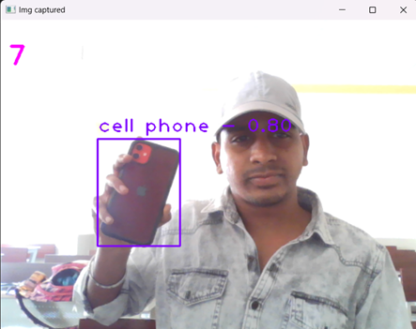
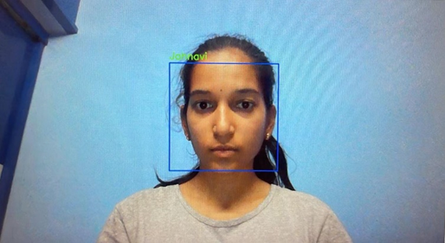
Objection Detection and Recognition
Infobot feature activated

Slide 22
Conclusion:
In conclusion, the development of intelligent robots with speech, object, and face recognition capabilities marks a significant stride in human-robot interactions. By addressing challenges in technology integration and privacy concerns, this project lays the groundwork for enhanced user experiences across diverse domains. The potential applications of such innovations extend to sectors like retail, healthcare, and hospitality, promising a future where robots seamlessly augment human activities while respecting privacy and user preferences.

Slide 23


